Slide 1



2.3 Using Email
Electronic mail
Message is sent/received through the internet
Email applications: Gmail, Yahoo! and Hotmail
Easy, immediate (only a few seconds) and cheap
Attach documents, reports, images etc.
Can be sent to more than one recipients

Slide 2
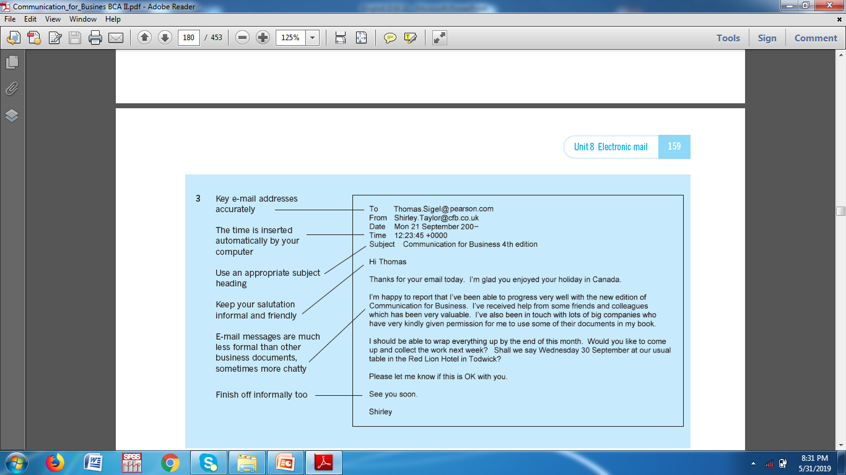
…
Emails have become the easy form of communication inside and outside of an organization
Replacing letters and memos
Fast, secure and confidential
Quicker feedback
Formal as well as informal purpose
Can attach the documents

Slide 3
Importance
Saves money and time
Prompt response
No need to speak to recipient
Messages can be marked as urgent
Messages can be read as useful
Incoming messages are saved
Emails reduce volume of paper
Can be sent to many recipients
Forward the information

Slide 4
Tips for writing effective email messages
Keep business and personal email separate.
Think twice before you hit “send.”
Proofread before you send.
Keep private information confidential.
Write informative subject lines.

Slide 5
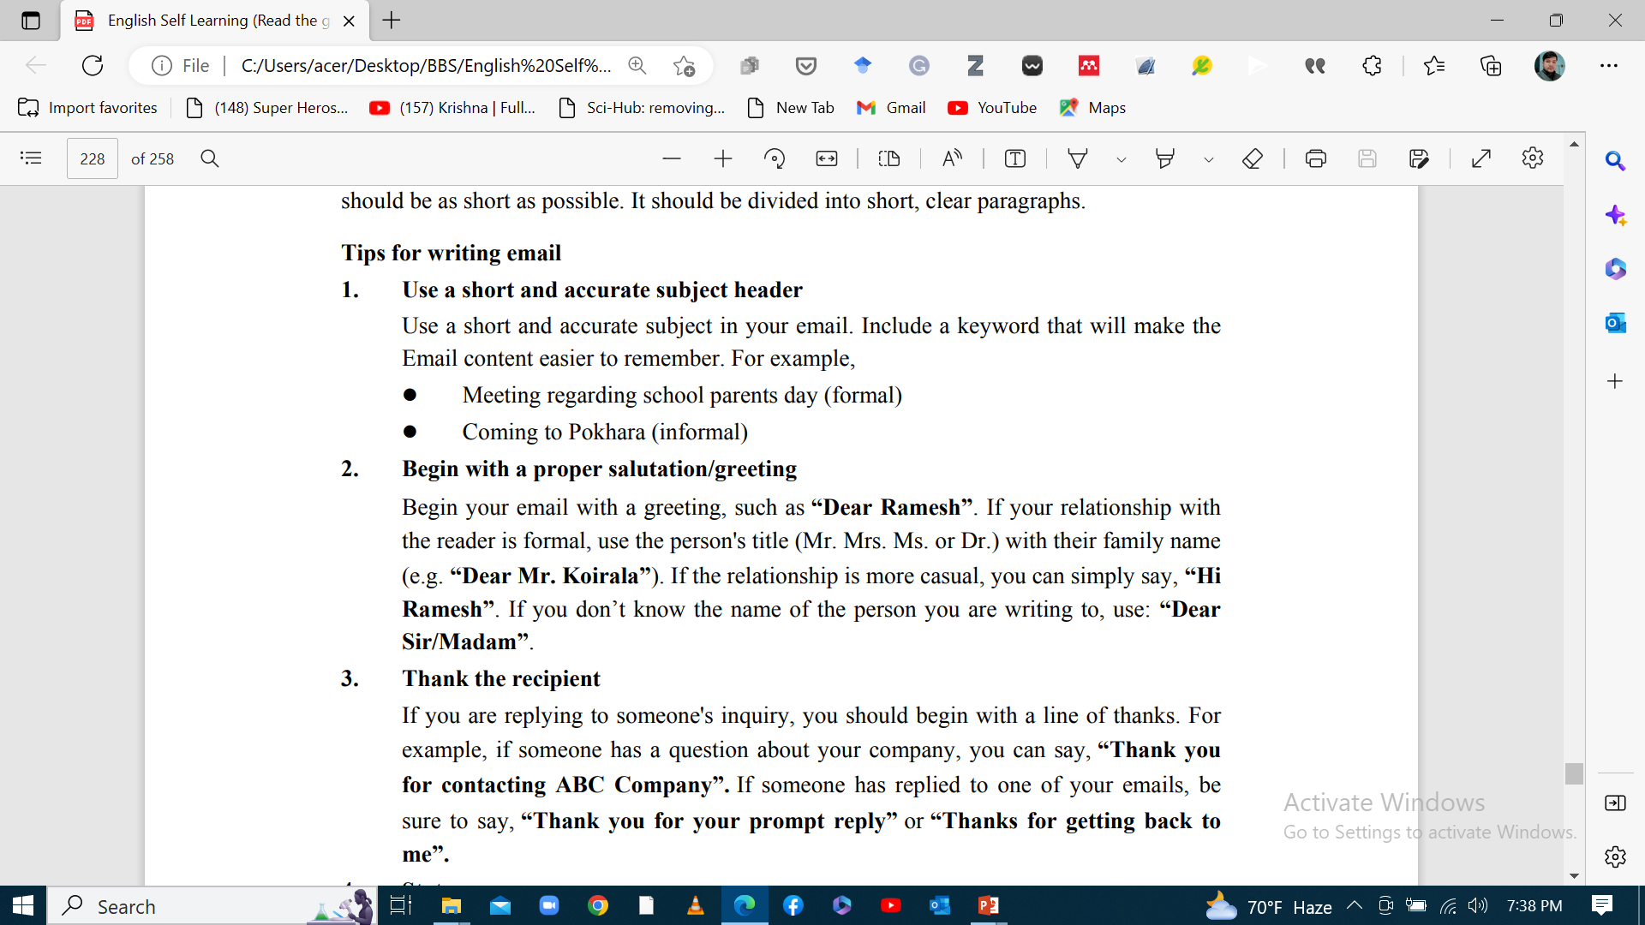

Slide 6
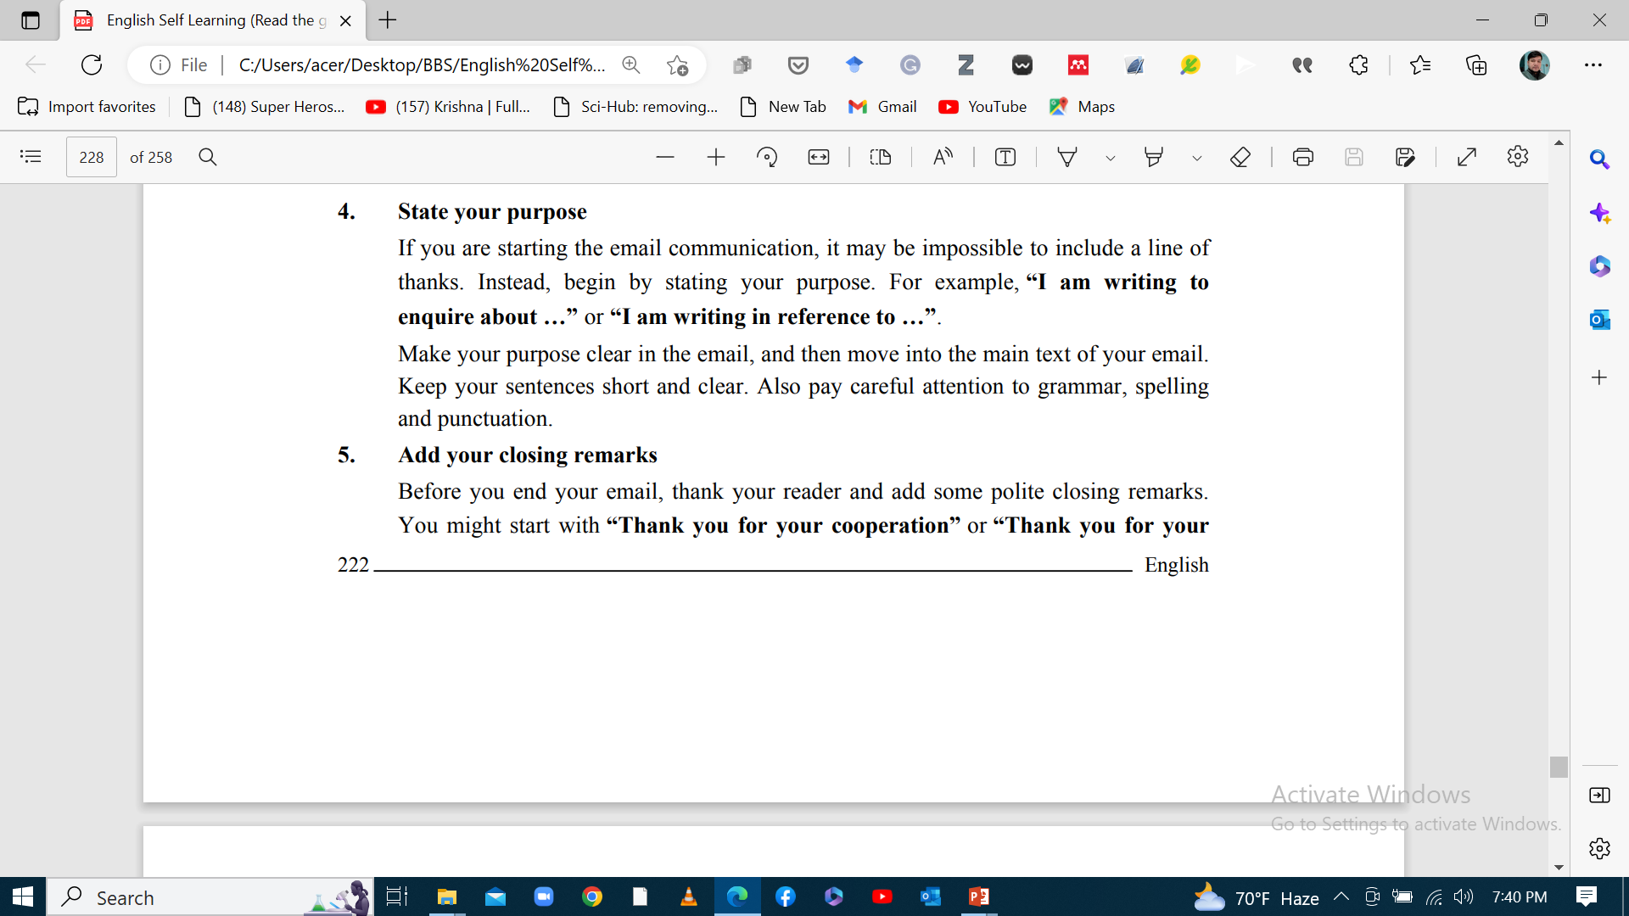

Slide 7
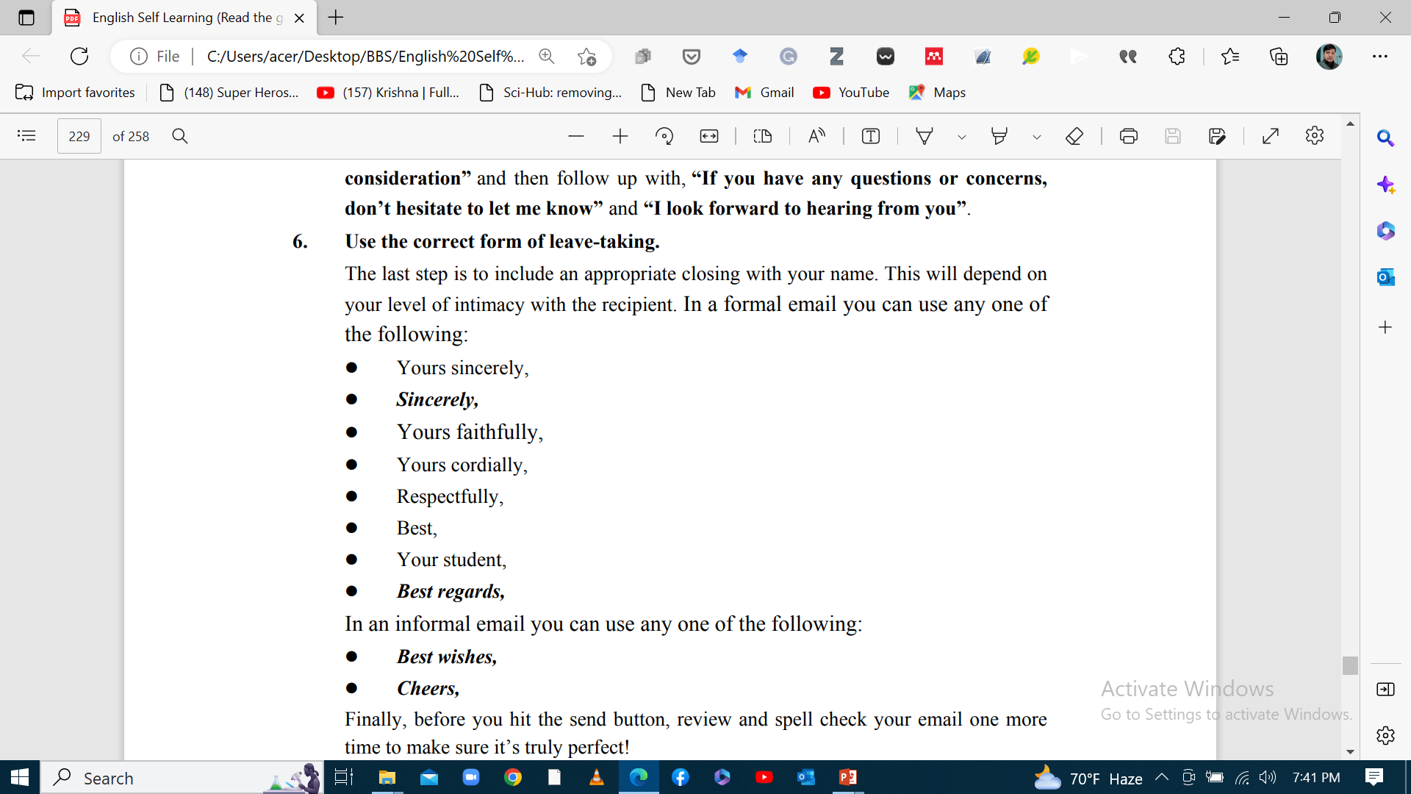

Slide 8
Some important things to pay attention
Format
Tone
Netiquette
Language
Managing your email account

Slide 9
A. Format
Avoid long and complex emails
Format to help access and read the message
Be careful when using unusual fonts or colors

Slide 10
B. Tone
Generally, less formal than standard letters
Business emails need to be formal
Recipient, nature and purpose of message determines the tone

Slide 11
C. Netiquette
Make the message easy and understandable
Use decent language
Do not spam (unsolicited mail)
Use email header carefully (must reflect the content of the body)
Avoid over use of emoticons, slangs and abbreviations
Respect the privacy of others

Slide 12
D. Language
Business letters in formal language
Pay attention to grammar, spelling and capitalization
Avoid using acronyms like LOL, BTW, Gr8 etc.

Slide 13
E. Managing your email account
Activate your signature file (to save time)
Don’t keep messages pile up in your inbox
Be careful about what to write in email
Keep up-to-date on email features

Slide 14
Samples

Slide 15
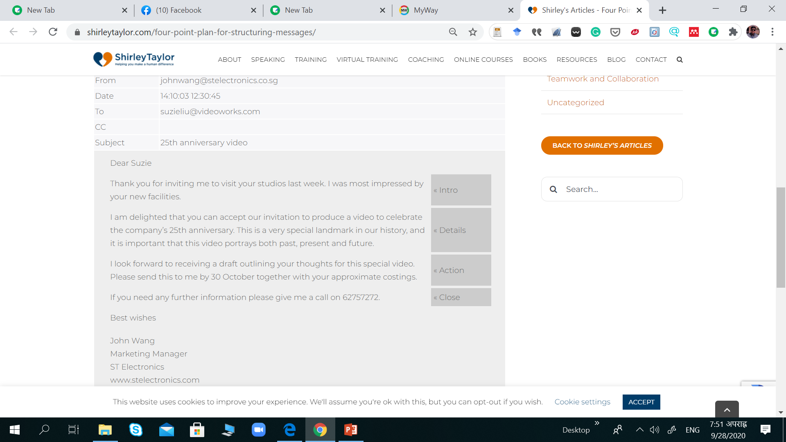

Slide 16
Forwarded message
From: sara@climbyoureverest.org
To: dawadimin2021@gmail.com
Date: Wed, Apr 19, 2023, 3:42 AM
Subject: Leadership Training Starting this Saturday
Hi everyone,
I hope this email finds you well. As a fellow educator, I know the importance of staying up-to-date with the latest teaching practices and techniques to create an engaging and inspiring learning environment for our students. That is why I am excited to invite you to a training program that is aimed at providing teachers with new teaching strategies and insights to improve their instructional effectiveness.
The program is entitled “Climb your Everest” and will take place on Saturday morning/ night from 8 to 9:30 on Zoom. This training program will be conducted by highly experienced and qualified instructors who have years of experience in the field of education. They will be sharing the latest research and trends in teaching methods and practices, as well as practical tips and tools to help you create a more engaging and interactive classroom environment.

Slide 17
Furthermore, the program will cover topics such as:
Developing critical thinking skills in students
Incorporating technology into classroom instruction
Enhancing creativity and innovation in the classroom
Creating a positive classroom culture
Implementing effective assessment strategies
Participating in this training program will not only help you improve your teaching skills but also provide an opportunity to network with other educators, exchange ideas, and gain inspiration from their experiences.
Please confirm your attendance by Thursday by replying to this email. Also, feel free to invite any other colleagues who might be interested in participating in this program.
Thank you for your dedication to the education profession, and I look forward to seeing you at the training.
Best regards,
Dr. Sara Safari
Author, Speaker, Coach

Slide 18
Assignment
Suppose you are working on a group project, and there are disagreements within the team. How would you address these conflicts through email to maintain a positive and collaborative atmosphere?

Slide 19

.

